Slide 1
Conservation of Energy – Nov 28
Agenda (90 min):
Checkpoint: Friction Research Project
Review Question
Discussion: Conservation of Energy
Practice Questions / Lab Prep
Hand Back Unit Test
Upcoming
Research Project – Due Wednesday, Nov 30
Lab – Tomorrow
Quiz – Wednesday (Types of Work, Kinetic & Gravitational Energy)

Slide 2
Review Questions
A 50 Kg girl jumping on a trampoline reaches a maximum height of 1.49 m above the surface of the trampoline. What is her gravitational potential energy?
Hint: E_{g} = mgh
Answer: 730J
If she reaches a speed of 5.41m/s just before she lands on the Trampoline, what is her kinetic energy at the surface of the trampoline?
Hint: E_{k} = ½ mv²
Answer: 730 J
When she comes to a stop at the bottom of her bounce, what happens to the energy?

Slide 3
Mechanical Energy (E_{m})
Mechanical energy refers to the total energy in a mechanical system.
E_{m} = E_{k} + E_{g} + E_{e}
It is composed of:
Kinetic Energy (E_{k})
Gravitational Potential Energy (E_{g})
Elastic Potential Energy (E_{e})
Elastic Potential Energy (E_{e})
Energy stored is springs and other stretched or compressed parts of the system (e.g. trampoline)

Slide 4
Isolated Systems
A system is a set of elements (objects) that influence one another.
When calculating work and energy we must consider all elements in the system.
An isolated system is a
Well defined (small) set of elements
That only influence each other
Are not influenced by elements outside the system

Slide 5
1st Year University Engineering Question
A refrigerator with its own power source sits inside an isolated room. If it is running with its door open, does the room?
Cool Down
Heat Up
Stay the Same

Slide 6
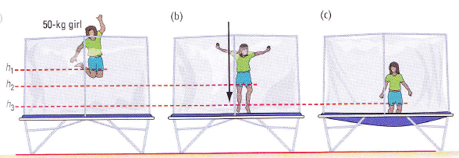
Our Trampoline System
E_{m} = E_{k} + E_{g} + E_{e}
E_{g} | = mgh | = 0 | = 0
E_{k} | = 0 | = ½ mv² | = 0
E_{e} | = 0 | = 0 | > 0

Slide 7
Conservation of Energy
A Fundamental Law of the Universe:
Energy can never be created or destroyed
It is only changed from one form to another
In an Isolated System:
The total amount of energy never changes
E_{m} = E_{k} + E_{g} + E_{e}

